Slide 1

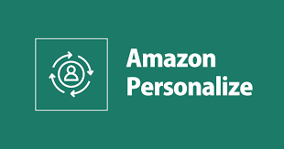
Recommender API with Amazon Personalize
Arka Ghosh
Notes:
This is an example of a Title Slide. We need to convey Life Is On in everything we do, so try to lead with compelling images that are vibrant, authentic, and human. The human element should be apparent and within the context of a segment that we touch.
To keep this PowerPoint template file size reduced, we included a small library of image choices in the Slide Master (under View). You can also get them from the SE Asset Library: https://schneiderelectric.telescopeondemand.com

Slide 2
What is a Recommendation Engine?
A type of data filtering tool using machine learning algorithms to recommend the most relevant items to a particular user or customer.
Netflix used recommendation engine to present viewers with movie and show suggestions.
Amazon, on the other hand, uses a recommendation engine to present customers with product recommendations.
Historically, recommendations would come from a salesperson or friends and family. Today, we have passed this task to algorithms.
Notes:
This is an example of a Text Slide. Reference the different layout options in the Slide Master (under the View tab) for different variations. Remember, our new Brand Guidelines call for clean and simple messages and design. Reference the PowerPoint Guidelines on the Brand Book for tips and useful information on creating effective presentations.

Slide 3
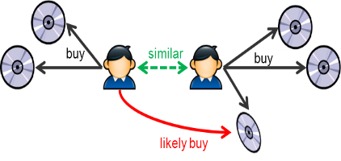
Type 1 - Collaborative Filtering
Collaborative filtering doesn’t need anything else but users’ historical preference on a set of items.
The standard method of Collaborative Filtering is known as Nearest Neighborhood approach.
There are user-based CF and item-based CF.
How to Find Similar Users on the Basis of Ratings?
Cosine Similarity
Pearson’s Correlation
Can lead to some problems like cold start for new items that are added to the list.

Slide 4
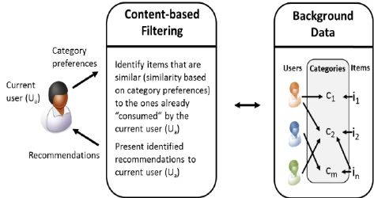
Type 2 - Content-based Filtering
It uses attributes of the content to recommend similar content. It doesn’t have a cold-start problem because it works through attributes or tags of the content.
In content-based filtering, recommendations are calculated based on the description of products.
It uses product features and recommends products to users that have similar features with those they rated highly during the past.
Content-based filtering does not require other users' data during recommendations to one user.

Slide 5
AWS Personalize - Introduction
Amazon Personalize is a ML service which enables you to personalize your website, app, ads, emails, and more, with custom machine learning models.
AWS announced that Amazon Personalize now supports ten times more item attributes for modeling in Personalize.
Previously, you could use up to 5 item attributes while building an ML model in Amazon Personalize. This limit is now 50 attributes.
You can now use more information about your items, for example, category, brand, price, duration, size, author, year of release etc., to increase the relevance of recommendations

Slide 6
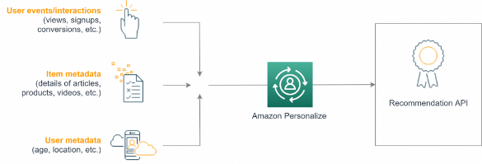
Solution Overview
Amazon Personalize: From datasets to a recommendation API
Amazon Personalize differentiates three types of input data:
user events called interactions (user events like views, signups or likes),
item metadata (description of your items: category, genre or availability), and
user metadata (age, gender, or loyalty membership).

Slide 7
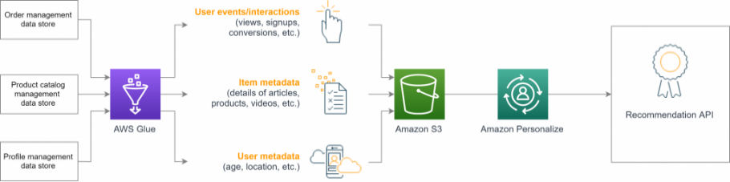
Data Ingestion – AWS Glue
AWS Glue is a serverless data integration service that is scalable and simple to use. You can even make use of data sources living outside of your AWS environment, e.g. on-premises data centers or other services outside of your VPC.

Slide 8
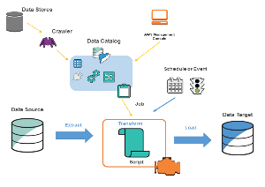
AWS Glue Data Catalog
A persistent metadata store containing table definitions, connection information and the ETL job definitions.
 | SOURCE | TARGET
DATABASE | ids_input_db | s3_output_db
CONNECTION | IDS ADL Dev Connection | S3 Connection
TABLES | analytical_edw_aws_personalize_users/items/interactions | aws_personalize_users/items/interations
CRAWLER | ids_adl_dev_aws_personalize_users_crawler | s3_adl_dev_aws_personalize_users_crawler
 | ids_adl_dev_aws_personalize_interactions_crawler | s3_adl_dev_aws_personalize_interactions_crawler
 | ids_adl_dev_aws_personalize_items_crawler | s3_adl_dev_aws_personalize_items_crawler
S3 |  | s3://amazon-personalize-data-storage/glue_incoming_data/
 | s3://amazon-personalize-data-storage/glue_scripts/
 | s3://amazon-personalize-data-storage/glue_logs/
 | s3://amazon-personalize-data-storage/glue_temp/
JOB | ids_adl_dev_aws_personalize_users_job
 | ids_adl_dev_aws_personalize_items_job
 | ids_adl_dev_aws_personalize_interactions_job
Intel DS
S3

Slide 9
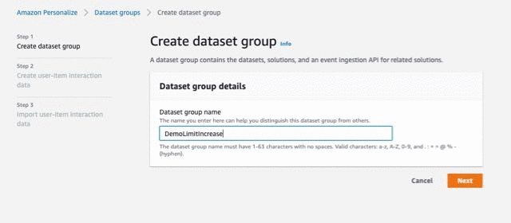
AWS Personalize – Create Dataset Group
Creating a dataset group
On the Amazon Personalize console, under Dataset groups, choose Create dataset group.
For Dataset group name, enter the name of your dataset group.
Choose Next.
AWS CLI
aws personalize create-dataset-group --name dataset group name

Slide 10
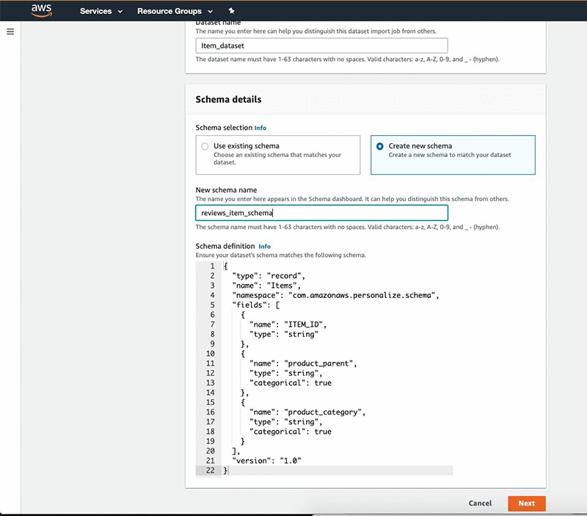
AWS Personalize – Create 3 Datasets
After you create the dataset group, create 3 datasets and define schema for each of them.
For Dataset name, enter a name(Items, Users, Interactions).
Under Schema details, select ”Create new schema”.
For New schema name, enter a name.
For Schema definition, enter the schema code.
AWS CLI
aws personalize create-schema \ --name SchemaName \ --schema file://SchemaName.json
Items Schema

Slide 11
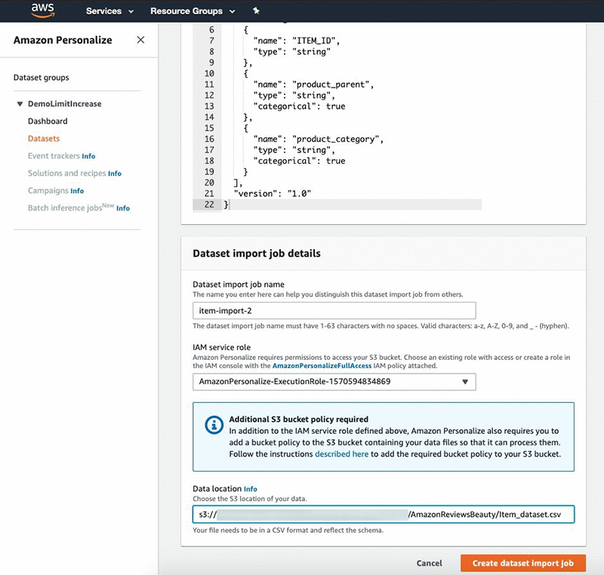
AWS Personalize – Importing the data
Make sure you provide Amazon Personalize read access to your bucket.
Under Dataset import job details, for Dataset import job name, enter a name.
For IAM Service role, choose AmazonPersonalize-ExecutionRole.
For Data location, enter the location of your S3 bucket.
Choose Create dataset import job.
Similarly, create 3 import jobs for items, users & interactions.

Slide 12
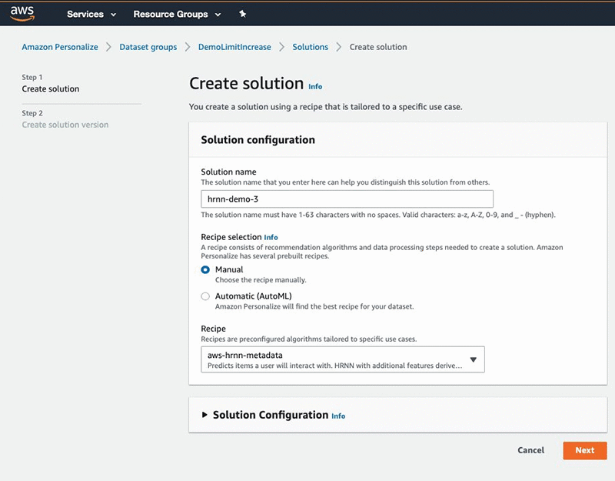
AWS Personalize – Model Training
After you ingest the data into Amazon Personalize, you are ready to train a model (Solution).
For user personalization, such as recommending items to a user, use one of the following recipes:
HRNN – Trains only on interaction data and provides a baseline
HRNN-Metadata – Trains on interaction+user, item, and interaction metadata and is recommended when you have such data available
HRNN-Coldstart – Use when you want to recommend cold (new) items to a user
For recommending items similar to an input item, use SIMS.

Slide 13
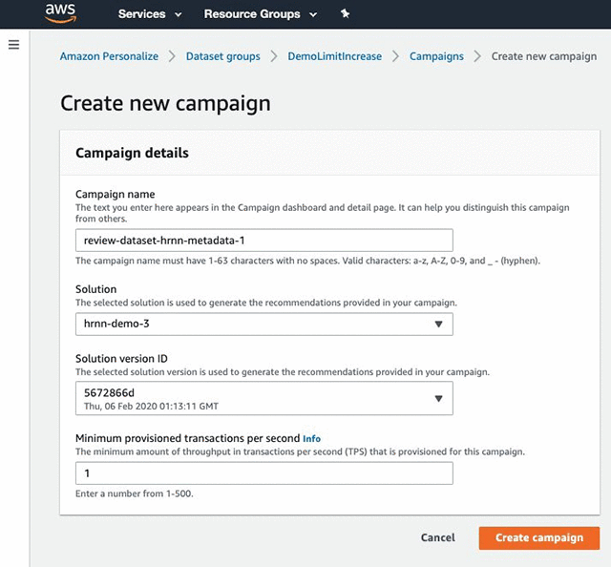
AWS Personalize – Getting Recommendations
To get recommendations, create a Campaign using the solution and solution version you just created.
Choose Campaigns.
Choose Create new campaign.
Under Campaign details, for Campaign name, enter a name
For Solution, choose the solution name from previous step.
For Solution version ID, choose the solution version you just created.
For Minimum provisioned transactions per second, enter 1.
Choose Create campaign.

Slide 14
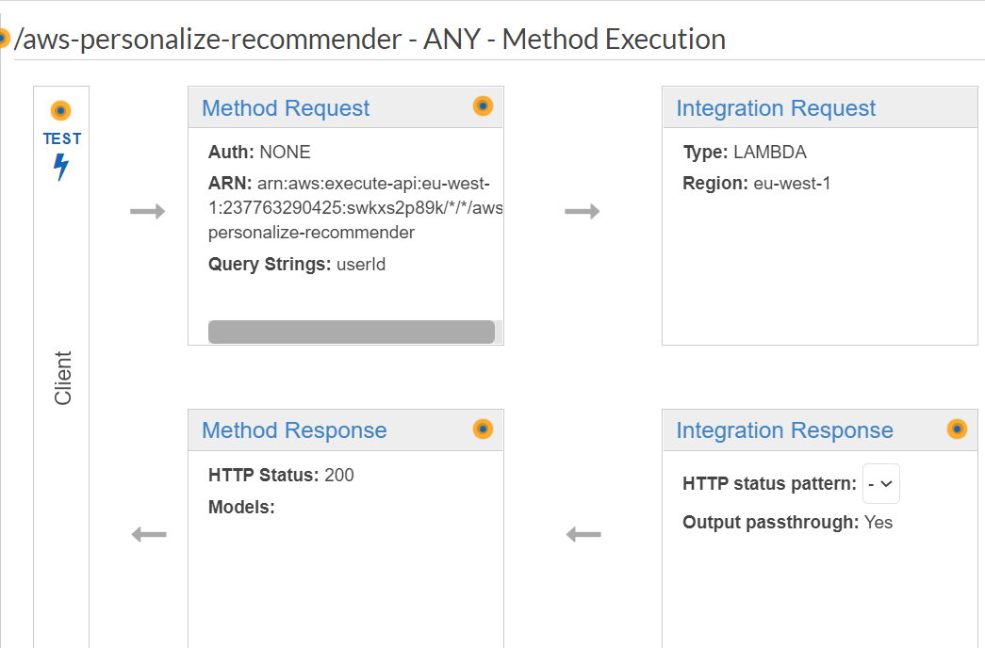
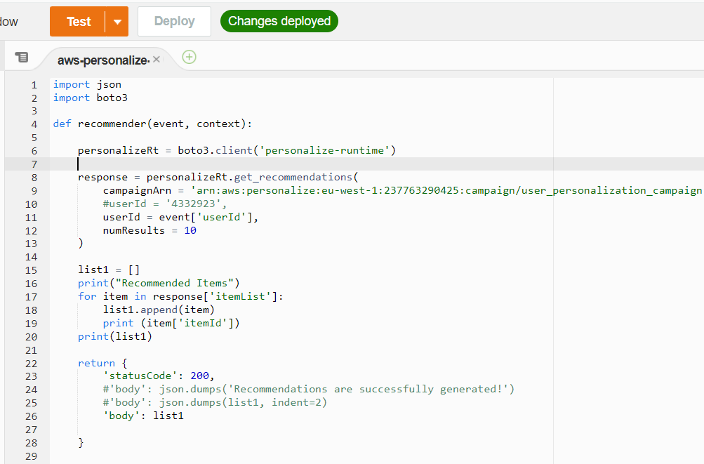
AWS Lambda & API Gateway
To get the recommendations programmatically, write a Lambda Function and link it to an API.
API Gateway - aws-personalize-recommender-API
AWS Lambda - aws-personalize-recommender

Slide 15
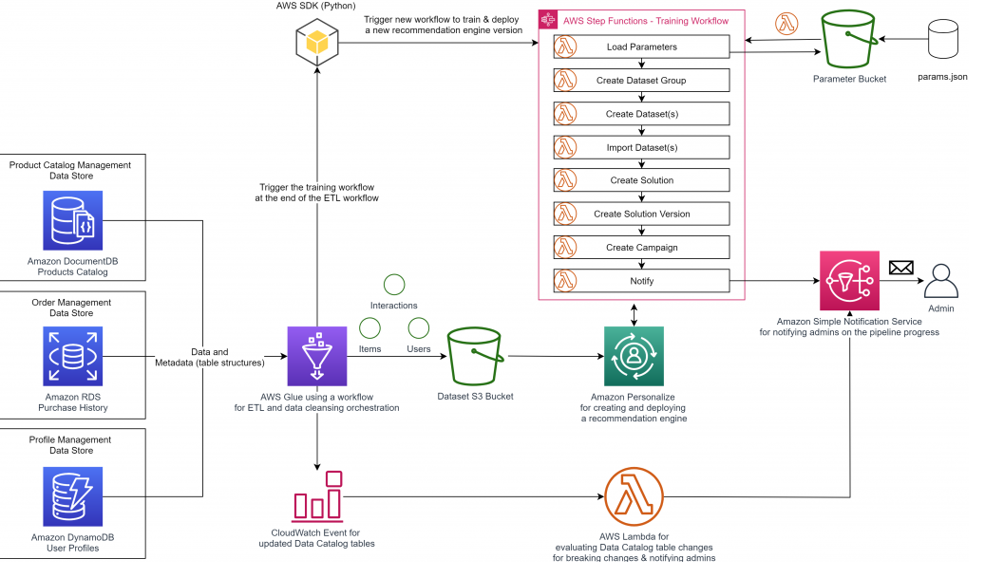
Serverless Architecture
A serverless architecture that takes userid as input and returns top N items as recommendations

Slide 16
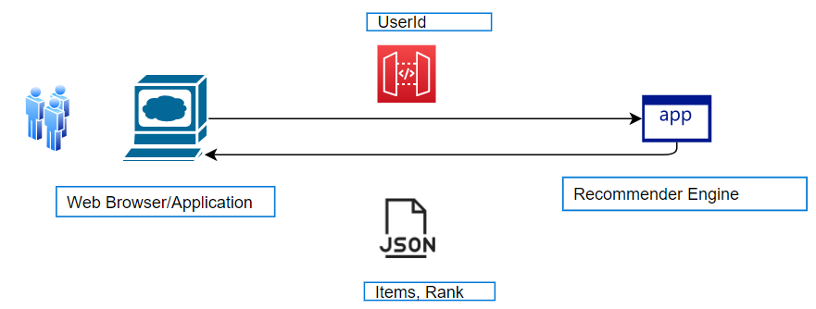
Invoking REST API
To call a deployed API, clients submit requests to the URL for the API Gateway component service for API execution, known as execute-api.
https://{restapi_id}.execute-api.{region}.amazonaws.com/{stage_name}/
where {restapi_id} is the API identifier, {region} is the Region, and {stage_name} is dev/qa/prod of the API deployment.
REST API
https://swkxs2p89k.execute-api.eu-west-1.amazonaws.com/default/aws-personalize-recommender?userId=52946117

Slide 17
Notes:
Closing slide

